Slide 1
Object Oriented Programming METHODOLOGY
Ruchika Patil
ruchika.rp@somaiya.edu

Slide 2
AGENDA
Arrays
For each loop
Arrays and Methods
Passing an array to Method
Anonymous Array in Java
Returning an array
Assignments

Slide 3
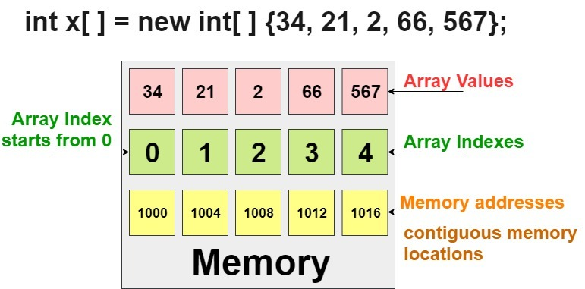
Arrays in Java
Array is a collection of similar type of elements that have contiguous memory location.

Slide 4
Enhanced for loop
Traversing technique - introduced in Java5.
Enables you to traverse the complete array sequentially without using an index variable.
It holds an array element in a variable, then executes the body of the loop.
Syntax
for (type var : array)
{
statements using var;
}

Slide 5
Java Program to print the array elements using for-each loop
class Testarray1{
public static void main(String args[]){ int arr[]={33,3,4,5};
//printing array using for-each loop
for(int i:arr)
System.out.println(i);
}
}
for (int i=0; i<arr.length; i++)
{
type var = arr[i];
statements using var;
}

Slide 6
Assignment Task (1)
WAJP SUM ALL ELEMENTS WITH A FOR-EACH LOOP

Slide 7
Limitations of for-each loop
It cannot traverse the elements in reverse order.
// cannot be converted to a for-each loop
for (int i=numbers.length-1; i>0; i--)
{
System.out.println(numbers[i]);
}
(2) For-each only iterates forward over the array in single steps

Slide 8
Limitations of for-each loop
3) For-each loops do not keep track of index. So we can not obtain array index using For-Each loop.
for (int num : numbers)
{
if (num == target)
{
return ???; // do not know the index of num
}
}

Slide 9
Limitations of for-each loop
4) For-each loops are not appropriate when you want to modify the array:
for (int num : marks)
{
// only changes num, not the array element
num = num*2;
}

Slide 10
Arrays and Methods
Passing Array to a Method
Returning Array from the Method

Slide 11
The following Java program demonstrates the passing of an array as a parameter to the function.
public class Main { //method to print an array, taking array as an argument private static void printArray(Integer[] intArray){ System.out.println("Array contents printed through method:"); //print individual elements of array using enhanced for loop for(Integer val: intArray) System.out.print(val + " "); }
public static void main(String[] args) {
//integer array
Integer[] intArray = {10,20,30,40,50,60,70,80};
//call printArray method by passing intArray as an argument
printArray(intArray);
}
}
}

Slide 12
Passing Array To The Method
When we pass an array to a method as an argument, actually the address of the array in the memory is passed (reference).
Any changes to this array in the method will affect the array.

Slide 13
Assignment Task (2)
WAJP to get the minimum number of an array using a method.

Slide 14
Anonymous Array in Java
An array in Java without any name.
Instant use (just for one time usage) .
Anonymous array is passed as an argument of method.
Syntax
// anonymous int array
new int[] { 1, 2, 3, 4};
// anonymous char array
new char[] {'x', 'y', 'z');

Slide 15
Anonymous Array in Java
// Java program to illustrate the
// concept of anonymous array
class Test {
public static void main(String[] args)
{
// anonymous array
sum(new int[]{ 1, 2, 3 });
}
public static void sum(int[] a)
{
int total = 0;
// using for-each loop
for (int i : a)
total = total + i;
System.out.println("The sum is:" + total);
}
}
In the above example just to call sum method we required an array but after implementing sum method, we are not using array anymore

Slide 16
Returning Array from the Method
public static void main(String args[]){
//calling method which returns an array
int arr[]=get();
//printing the values of an array
for(int i=0;i<arr.length;i++)
System.out.println(arr[i]);
}}
//Java Program to return an array from the
method
class TestReturnArray{
//creating method which returns an array
static int[] get(){
return new int[]{10,30,50,90,60};
}

Slide 17
Return An Array In Java
While returning a reference to an array from a method, you should keep in mind that:
The data type that returns value should be specified as the array of the appropriate data type.
The returned value from a method is the reference to the array.
The array is returned from a method in the cases where you need to return multiple values of the same type from a method. This approach becomes useful as Java doesn’t allow returning multiple values.

Slide 18
The following program returns a string array from a method.
import java.util.*;
public class Main
{
public static String[] return_Array() {
//define string array
String[] ret_Array = {"Java", "C++", "Python", "Ruby", "C"};
//return string array
return ret_Array;
}
public static void main(String args[]) {
//call method return_array that returns array
String[] str_Array = return_Array();
System.out.println("Array returned from method:" + Arrays.toString(str_Array));
}
}

Slide 19
Assignment Task (3)
(1) WAJP for Passing two dimensional array to method for
computing transpose of matrix.

Slide 20
Assignment (Extra)
Write a program with an array that is initialized with test data.
Use any primitive data type of your choice. The program should also
have the following methods.
getTotal: This method should accept a one-dimensional array as its
argument and return the total of the values in the array.
Similarly,
getAverage: This method should accept a one-dimensional array as its
argument and returns the average of the values in the array.
getHighest: This method should accept a one-dimensional
array as its argument and return the highest value in the array.
getLower: This method should accept a one-dimensional
array as its argument and returns the lowest value in the array.
Demonstrate each of the methods in the program.

Slide 21
Important point about Java arrays.
Arrays in Java are Objects.
In Java all arrays are dynamically allocated.
Java array can be also be used as a static field, a local variable or a method parameter.
The size of an array must be specified by an int value and not long or short.
The direct superclass of an array type is Object.
Array can contains primitives data types as well as objects of a class depending on the definition of array.
In case of primitives data types, the actual values are stored in contiguous memory locations.
In case of objects of a class, the actual objects are stored in heap segment.

